Slide 1
az aks create --name foo --resource-group bar

Slide 2
az aks create --name foo --resource-group bar

Slide 3
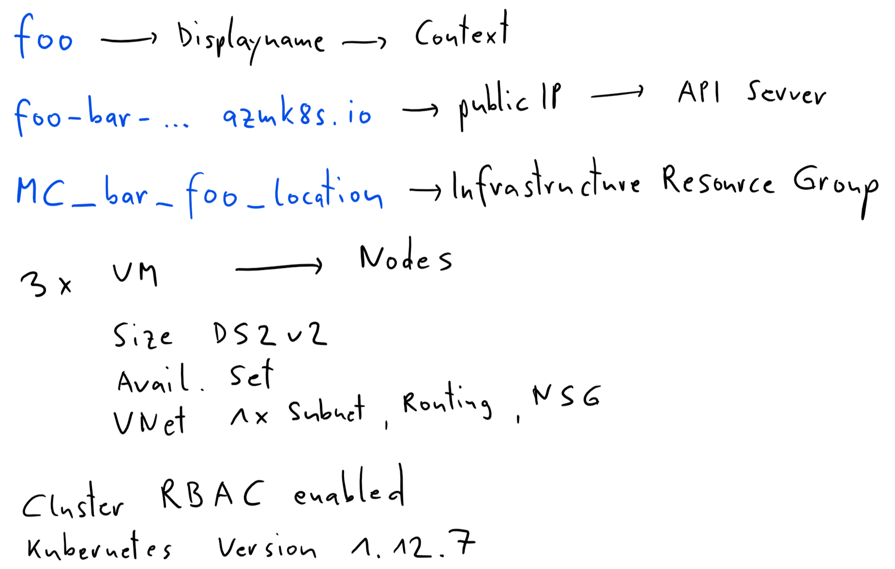
az aks create --name foo --resource-group bar

Slide 4
docker pull nginx
docker pull docker.io/nginx:latest

